Slide 1
Files in Python
Purdue University

Slide 2

Reading and Writing Files in Python
Python can be used to automatically read and write files:
Automatically write log files
Extract information from files
Automatically process files

Slide 3
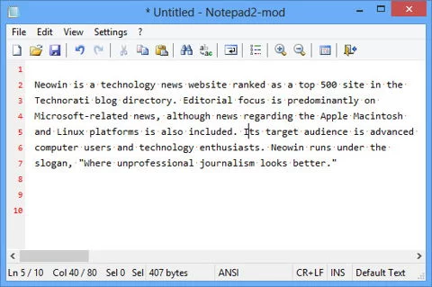
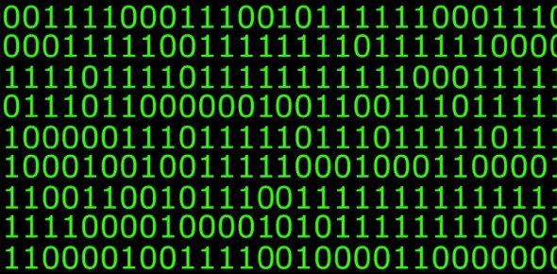
File Types in Python
Plain Text
Text files with no formatting (.txt, .py, .html, etc.)
Binary
All other files (jpg, pdf, exe)
Would look like gibberish if you opened them in Notepad

Slide 4

OS module
The os.py module makes some Operating System features available to Python.
We will be using this module to:
Manipulate paths
Make folders
Make files

Slide 5
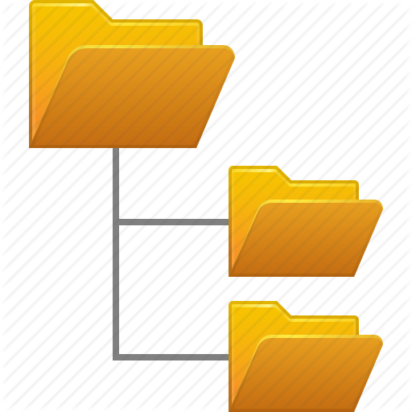
OS: Manipulating File Paths
Import the os.py library
import os
Returns the current directory that Python is in:
os.getcwd()
Changes the current working directory of Python:
os.chdir(<Absolute Path to Directory>)

Slide 6
OS: Manipulating File Paths (Cont.)
Returns the absolute path of the specified file / directory
Absolute path: Path starts from root directory
os.path.abspath(‘<folder / file>’)
Returns the relative path of the specified file / directory
relative path: Path is relative to the current directory
os.path.relpath(‘<destination path>, <start path>’)
Returns true if the path is an absolute path, otherwise returns false:
os.path.isabs(‘<path>’)

Slide 7
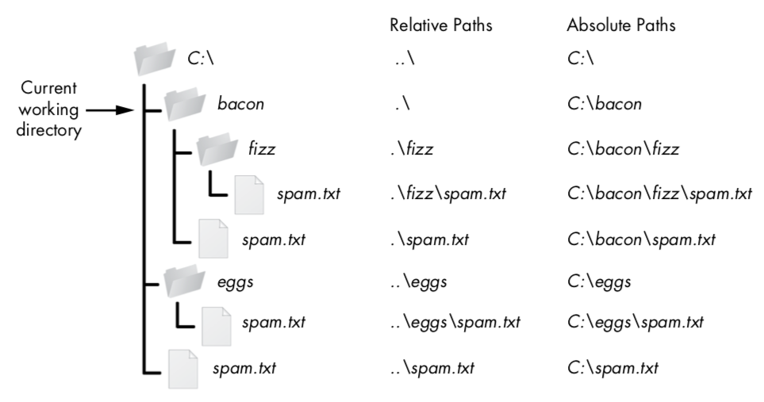

Slide 8
OS: Manipulating File Paths (Cont.)
Returns a path string that joins all objects specified.
os.path.join(‘<object 1>’,’<object 2>’, etc....)
Returns a list of string of directories that make up the current path
<path>.split(os.path.sep)
Returns an array with all files within a folder.
os.listdir(‘<path>’)

Slide 9
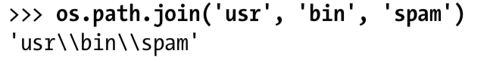
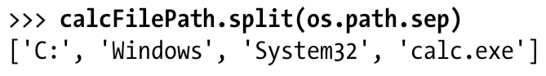
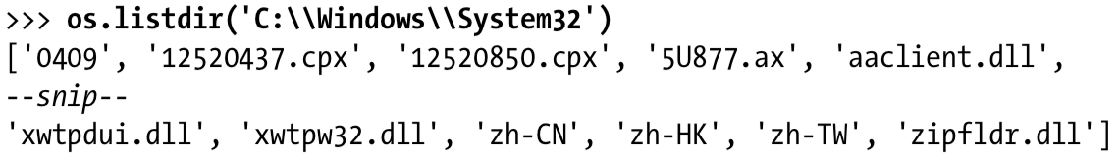

Slide 10
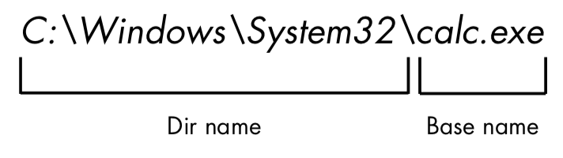
OS: Manipulating File Paths (Cont.)
Returns the directory name of a path
os.path.dirname(‘<path>’)
Returns the base name of a path
os.path.basename(‘<path>’)
Returns a tuple with the basename and directory name of the path
os.path.split(‘<path>’)

Slide 11
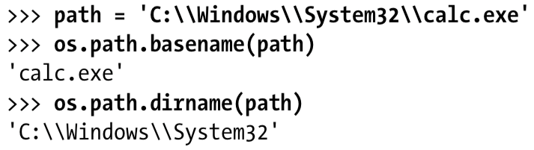
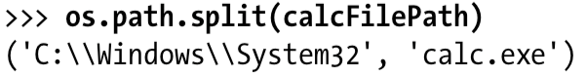

Slide 12
OS: Path Checking
Returns True if the path exists
os.path.exists(‘<path>’)
Returns True if the path leads to a directory
os.path.isdir(‘<path’>)
Returns True if the path leads to a file
os.path.isfile(‘<path’>)

Slide 13

OS: Misc
Creates a folder at the given path. Can create multiple folders:
os.makedirs(‘<path>’)
Returns the size (in bytes) of the file in the path:
os.path.getsize(‘<path>’)

Slide 14
The File Object
Python uses File Objects to handle the manipulation of files. This is part of the Python IO module.
The open() function returns a File Object that can then can be assigned to a variable
File = open(‘<path>’,’<flags>’)

Slide 15
open()
open() can take in a variety of different flags which will set it to different modes:
Adding these characters to the end of the flag will:
b :signifies that the file being manipulated is binary
+ :opens the file for both reading and writing
-r :for reading
-rb :for reading binary
-w :for writing
-r+ :for reading and writing
-wb :for writing binary
-w+ :allows writing and reading
-wb+ :allows writing and reading of binary
-a :Opens the file for appending.
-a+ :Opens the file for appending and reading
-ab :Opens binary file for appending
-ab+ :Same as ab but allows for writing

Slide 16

Reading a file
Flags:
-r :Reading only
-r+ :Reading and Writing
-rb :For reading binary files
-rb+ : Same thing as r+ but for binary
Reads from the beginning of the file. Files can only be read once per open() call!
Reader = open(‘myfile.txt’, ‘r’);

Slide 17
Reading a file (cont.)
Once you have your File Object, you can use the read() function to output file contents as one big string:
<File Object>.read()
For better separability, use readlines(), which outputs strings separated by the ‘\n’ as items in an array
<File Object>.readlines()
Both of these have a <size> flag where you can specify the amount of bytes you want to read.

Slide 18
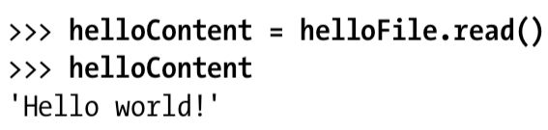
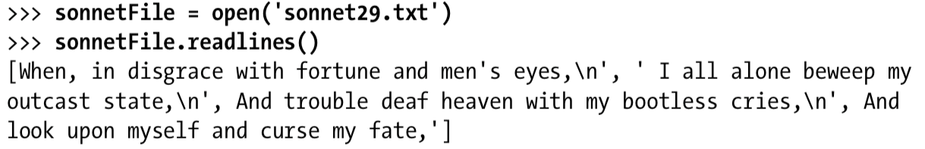

Slide 19
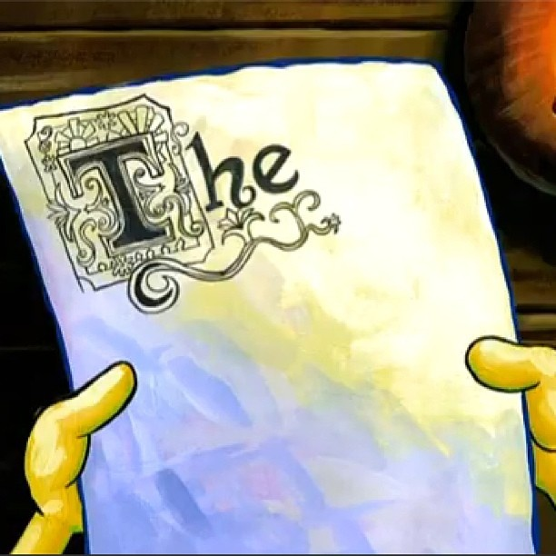
Writing a File
Flags:
-w :Writing only
-w+ :Reading and Writing. Creates a file if one isn’t created already.
-wb :For writing binary files
-wb+ : Same thing as w+ but for binary
Writes from the beginning of the file and will overwrite files that already exist. Use -a+ if you want to continue writing from a file.
Writer = open(‘myfile.txt’, ‘w’)

Slide 20

Appending a File
Flags:
-a :appending only
-a+ :Reading and Writing. Creates a file if one isn’t created already.
-ab :For appending binary files
-ab+ : Same thing as a+ but for binary
Starts from the end of the file. Used to append to existing files.
Appender = open(‘myfile.txt’, ‘a’)

Slide 21
Adding to files
Once you have your File Object, you can use the write() function to write contents to the file:
<File Object>.write(‘<string>’)
Make sure to close the file when you are done writing using close().
<File Object>.close()

Slide 22
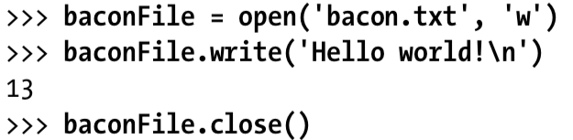
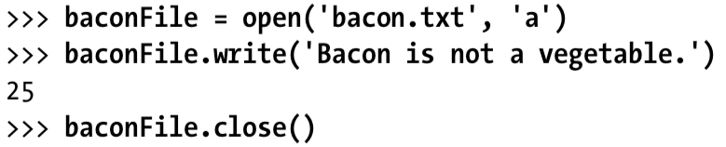
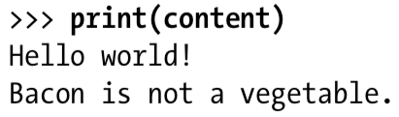

Slide 23

Reading from Multiple Files
File input module allows us to load multiple files into one File Object:
Import fileinput module.
import fileinput
Use the .input() function
fileinput.input()

Slide 24
input() function
The input() function has several parameters:
files :takes a series of strings that are the name of the files you want to load
Defaults to ‘none’
fileinput.input(files=(‘<file 1>’, ‘<file 2>’))
inplace :if set to True, allows lines to edit lines of the file in place
backup :specifies the backup file extension
fileinput.input(backup=’<file extension>’)
Defaults to ‘.bak’
There are many other optional parameters for this function but they aren’t as important. Check out Python 3 documentation for more information

Slide 25
Fileinput functions
There are many methods for fileinput objects (fileinput.<function>):
filename() :Returns current file name
lineno() :Returns the total number of lines read. Returns 0 if no lines read
filelineno() :Returns the line in the file being read. Returns 0 if no lines read
isfirstline() :Returns True if the line read is the first line of the file.
nextfile() :Switches to the next file loaded
close() :Close the stream
There are other functions available but they have been omitted because they aren’t as important. Check out Python 3 documentation for more information.

Slide 26
Using fileinput
Use an iterator (loops) to iterate over each line of the text in the fileinput object
with fileinput.input(files=('spam.txt', 'eggs.txt')) as f: for line in f: print(line)

Slide 27

Saving config Variables with Shelve
When writing Python programs, we might want to save some configuration variables.
The shelve module allows us to save configuration variables in a separate file.
Shelve stores variable data in key value pairs (dictionary).

Slide 28
Shelve: Writing Variables
Import the Shelve module:
import shelve
Open a data file (no file extension needed) and assign it to a variable. One will be created if one doesn’t exist.
<ShelfFile variable> = shelve.open(‘<name of data file>’)

Slide 29
Shelve: Writing Variables (cont.)
Assign your data to a key in the variable:
<ShelfFile variable>[‘<key>’] = <data>
Close the shelve stream:
<ShelfFile variable>.close()
Your data is saved in the following files:
Windows:
<variable>.bak
<variable>.dat
<variable>.dir
OSX:
<variable>.db

Slide 30
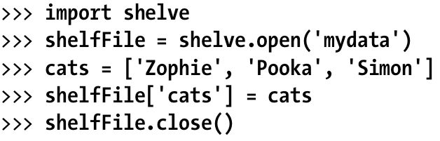

Slide 31
Shelve: Accessing Saved Variables
In your python program, import shelve and open the data file
import shelve
<ShelfFile variable> = shelve.open(‘<name of data file>’)
Reference access the value using the key we saved last time
<value> = <ShelfFile variable>[‘<key>’]

Slide 32
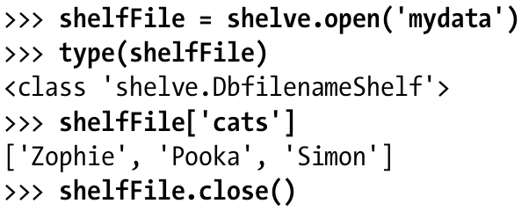

Slide 33

Writing Python files with pprint
The pprint.pformat()function will output contents of Dictionary or list as a syntactically valid piece of Python code.
We can use this to aid us in automatically writing .py files.

Slide 34
Writing Python files with pprint (cont.)
Import the pprint module
import pprint
Open a .py file for writing
<py file variable> = open(‘<.py file>’, ‘w’)
Use pprint.pformat() to write your list or dictionary variable to the new .py file
<py file variable>.write(pprint.pformat(<dictionary/list>))

Slide 35
